Slide 1
Graph Metrics & Measures
Presentation within the Big Data Practicium
Toni Pohl, Lukas Werner

Slide 2
Table of contents
Introduction
Measures and Metrics
Weakly Connected Components
Visualization
Leasons learned?

Slide 3
Introduction
Java - Flink - Gelly
Foodbroker - Graph Data Generator
R - knitr - D3js - Bootstrap

Slide 4
Measures and Metrics
Average Vertex degree
Vertex & Edge count
Label & Attribute count
Global Cluster Coefficient
Weakly Connected Components

Slide 5
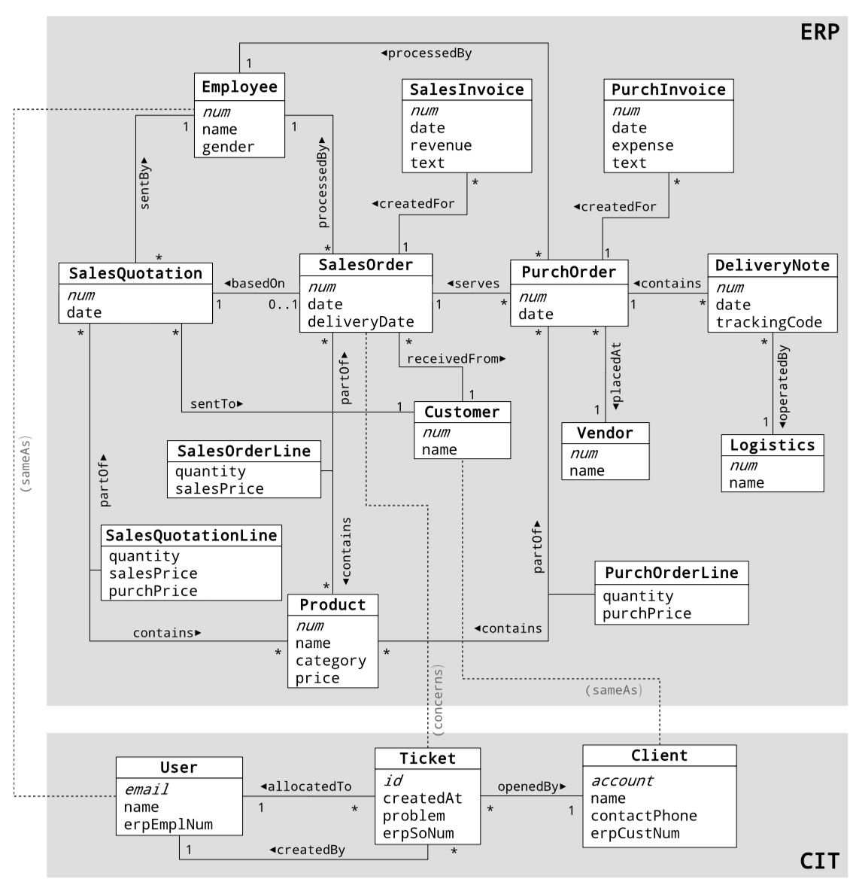
Foodbroker Graph
ERP - Enterprise resource planning
CIT - Customer issue tracking

Slide 6
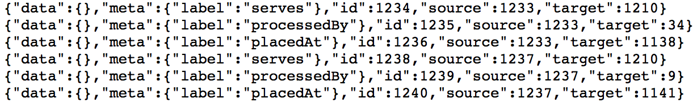
Foodbroker Graph

Slide 7
Weakly Connected Components
Algorithm to Calculate the WCC of a Graph

Slide 8
Weakly Connected Components Introduction
E
D
A
B
F
H
C
G

Slide 9
Weakly Connected Components Algorithm
Iterations: 3 Number of components: 1 Sizes of components: {3} (Vertices) Biggest component‘s size: 3
Hi there, I‘m in component blue
But, but, … blue is so wonderful! I don‘t want to be red…
Well, then I have to take blue, I guess…
So B is in blue, I‘m in red. I have to choose one. Let‘s take the minimum, red!
B
A
C
Assumption: red < blue < green
Notes:
Algorithmus basiert auf Nachrichtenaustausch durch Knoten
Vertexzentriert
Iterativ
Solange bis sich nichts mehr ändert

Slide 10
Weakly Connected Components Implementation
Undirect edges (if necessary)
Source-Key | Target-Key
1 | 2
2 | 1
3 | 4
3 | 5
4 | 3
4 | 5
5 | 3
5 | 4
2
1
5
3
4
Notes:
FlatMap

Slide 11
Weakly Connected Components Implementation
Start by defining every vertex as its own component
Vertex-Key | Component
1 | 1
2 | 2
3 | 3
4 | 4
5 | 5
2
1
5
3
4
Notes:
Map

Slide 12
Weakly Connected Components Implementation
Send own component id along the outgoing edges
Vertex | (Outgoing) Edge
(1, 1) | (1, 2)
(2, 2) | (2, 1)
(3, 3) | (3, 4)
(3, 3) | (3, 5)
(4, 4) | (4, 3)
(4, 4) | (4, 5)
(5, 5) | (5, 3)
(5, 5) | (5, 4)
1
2
1
3
5
2
3
5
3
4
5
4
4
Notes:
Join

Slide 13
Weakly Connected Components Implementation
Targets receive the messages
Target-Key | Incoming Msg.
1 | 2
2 | 1
3 | 4
3 | 5
4 | 3
4 | 5
5 | 3
5 | 4
1
2
1
3
5
2
3
5
3
4
5
4
4
Notes:
Join-Filter

Slide 14
Weakly Connected Components Implementation
Collect all the received messages …
Vertex-Key | Grouped Msg.
1 | {2}
2 | {1}
3 | {4, 5}
4 | {3, 5}
5 | {3, 4}
{1}
{2}
2
{3, 4}
1
{4, 5}
5
3
4
{3, 5}
Notes:
Group

Slide 15
Weakly Connected Components Implementation
… and consistently accept one of them (here minimum)
Vertex-Key | Accepted Msg.
1 | 2
2 | 1
3 | 4
4 | 3
5 | 3
1
Vertex-Key | Grouped Msg.
1 | {2}
2 | {1}
3 | {4, 5}
4 | {3, 5}
5 | {3, 4}
2
2
3
1
4
5
3
4
3
Notes:
Aggregate

Slide 16
Weakly Connected Components Implementation
Compare with previous state and take the minimum
Vertex-Key | Component
1 | 1
2 | 1
3 | 3
4 | 3
5 | 3
1
1
2
3
1
3
5
3
4
3
Repeat this until nothing changes anymore or the maximum of iterations were reached
Notes:
New WorkSet

Slide 17
Visualization

Slide 18
Lessons learned?
Documentation in need of improvement
Scala instead of Java
Simply applicable
Do not demand too much of your computer!

Slide 19
Sources
https://flink.apache.org
https://github.com/dbs-leipzig/foodbroker
http://getbootstrap.com
http://d3js.org
https://www.r-project.org
http://yihui.name/knitr/
https://github.com/lukaswerner/BigData_GraphMetrics
https://en.wikipedia.org/wiki/Connected_component_(graph_theory)
https://kowshik.github.io/JPregel/pregel_paper.pdf

